Slide 1
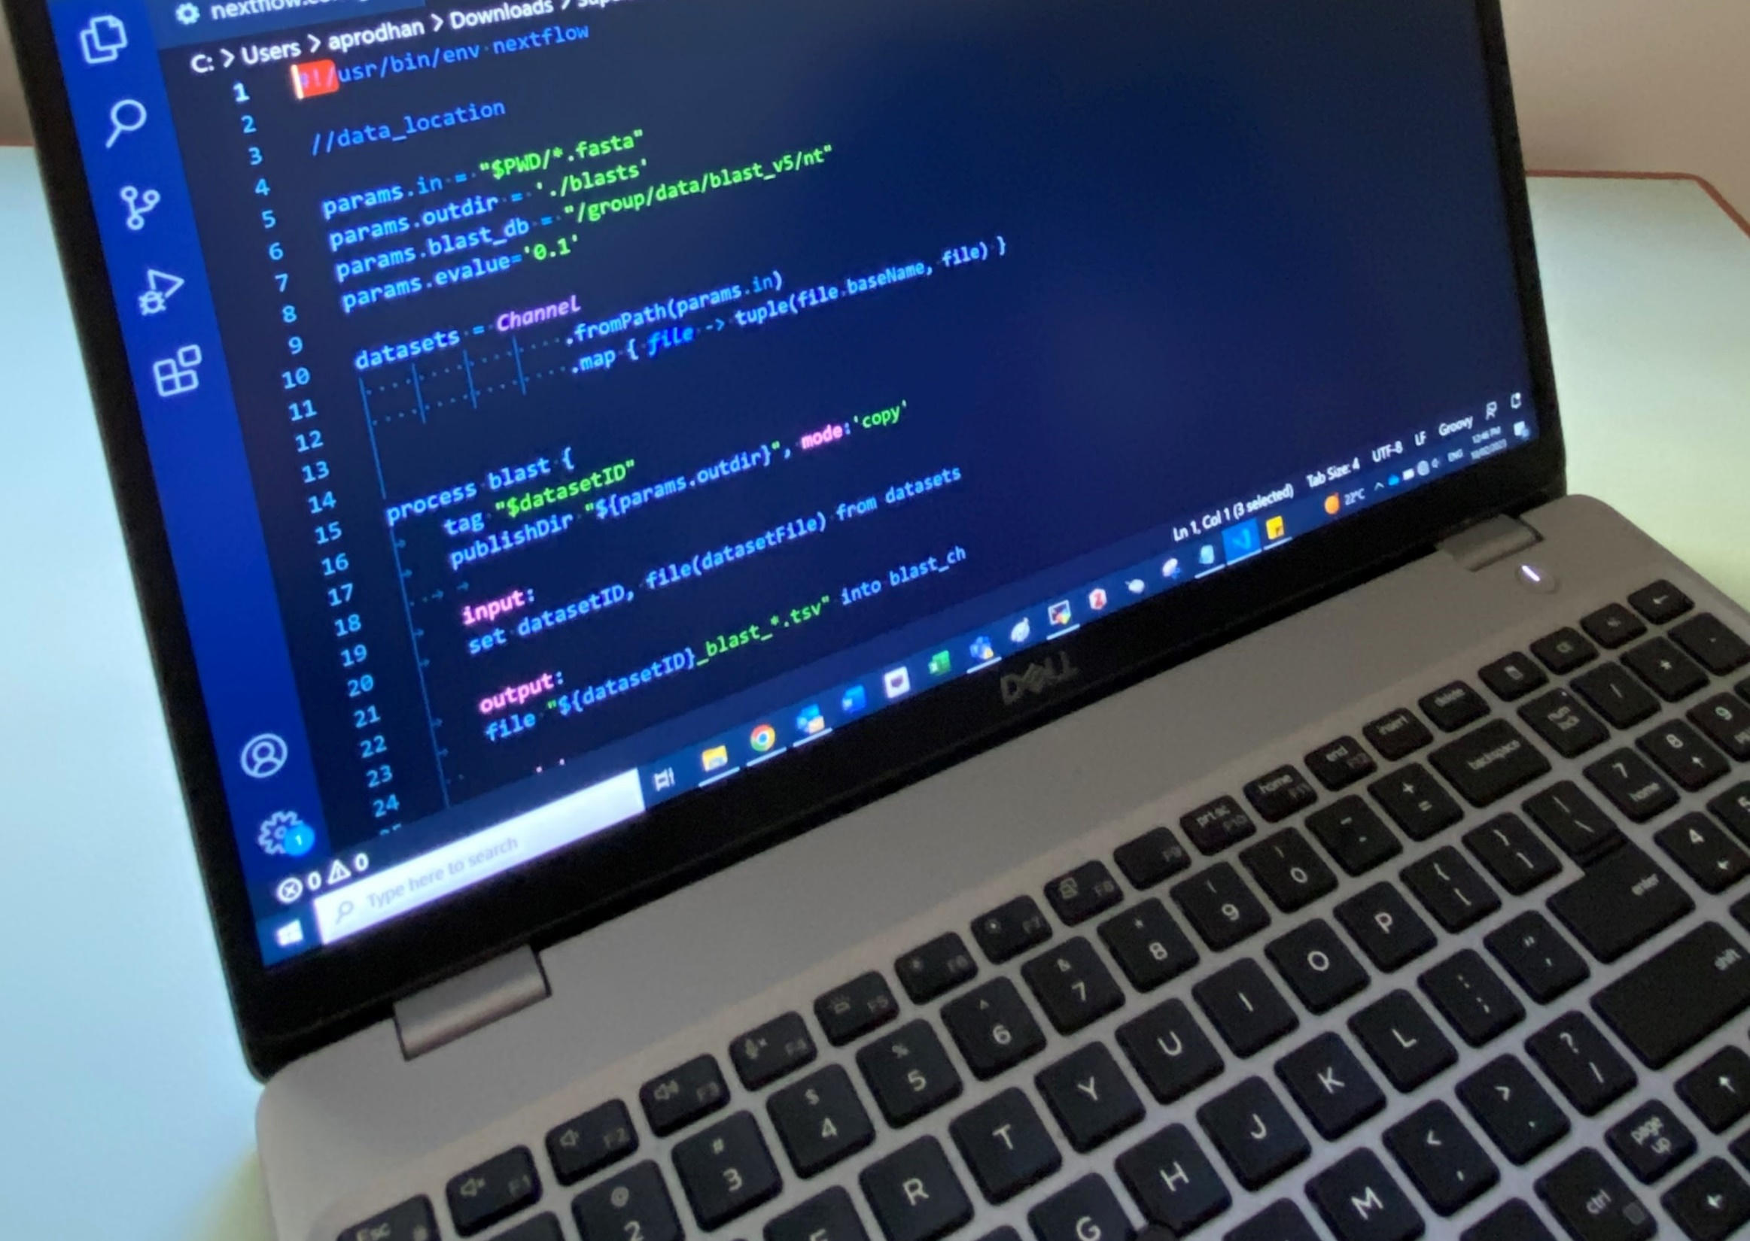
Introductory Bioinformatics: Where do I start?
Asad Prodhan PhD
asadprodhan.github.io

Slide 2
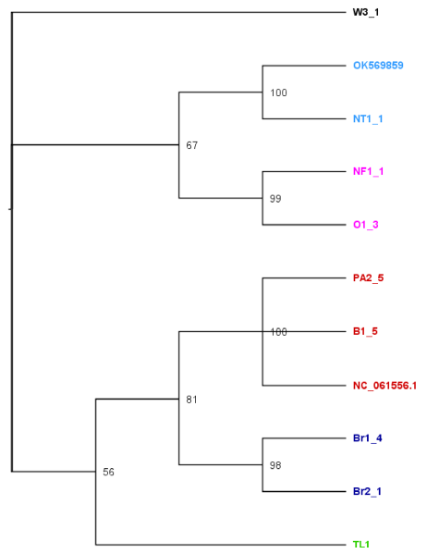

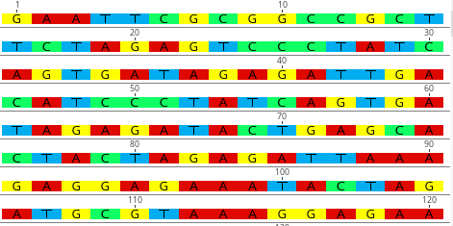
What is bioinformatics?
Bioinformatics = Biological Information Processing
Biological Information (DNA sequence data)
Processing
(Computer + Computing)
Biological Insight
(Phylogenetic tree)
nature.com/articles/s41598-023-37425-1
Asad Prodhan PhD

Slide 3

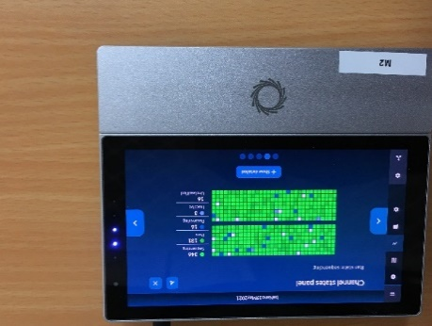
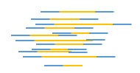
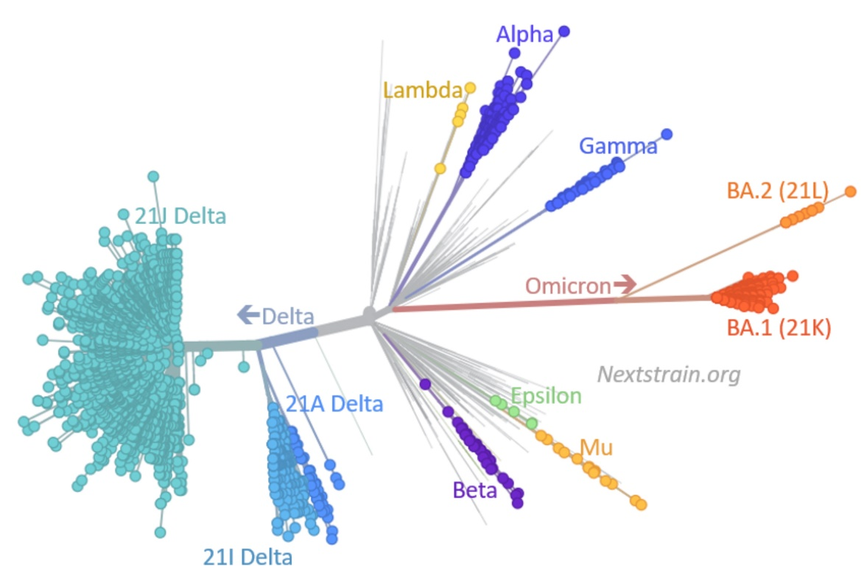
Bioinformatics applications. An example
SARS-CoV-2
Tested positive
but what variant?
DNA extraction
Library prep
DNA sequencing
Bioinformatics analysis of SARS-CoV-2 evolution,
adopted from Dr Emma Hodcroft, Nextstrain
Asad Prodhan PhD

Slide 4
Where do I start?
A biological question
Data (new/secondary)
A computer (GUI/CLI)
If CLI, then programing
Asad Prodhan PhD

Slide 5
Where do I start?
A biological question
Data (new/secondary)
A computer (GUI/CLI)
If CLI, then programing
PhD research proposal
Bioinformatics project ideas, https://www.youtube.com/watch?v=VoqbmLuw5Tw
Asad Prodhan PhD

Slide 6
Where do I start?
A biological question
Data (new/secondary)
A computer (GUI/CLI)
If CLI, then programing
What data do you need?
Read publications (M & M)
New data?
How to generate? An example https://github.com/asadprodhan/Invited_talks/blob/main/Nanopore_Workshop_AsadProdhan_DPIRD.pdf
Secondary data?
How to download? Tutorials: https://www.linkedin.com/feed/update/urn:li:activity:7161193395183325184/
Asad Prodhan PhD

Slide 7
Where do I start?
A biological question
Data (new/secondary)
A computer (GUI/CLI)
If CLI, then programing
GUI: any operating system
CLI: Mac/Linux/WSL/VirtualBox
Asad Prodhan PhD

Slide 8
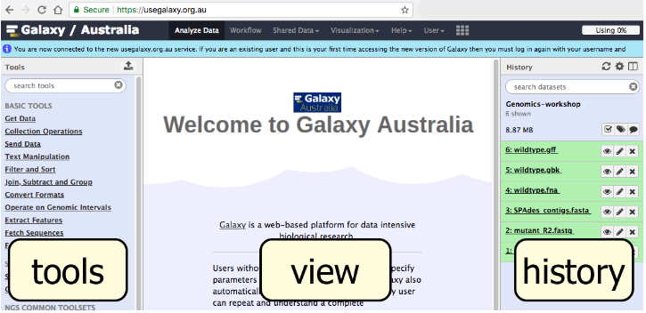
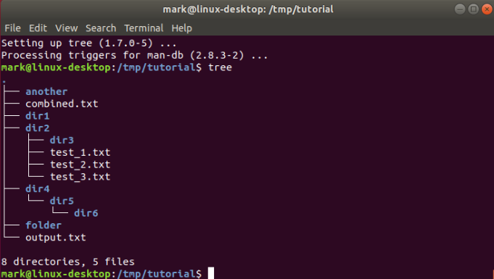
GUI
CLI
https://galaxy-au-training.github.io/tutorials/modules/galaxy/
https://ubuntu.com/tutorials/command-line-for-beginners#1-overview
Asad Prodhan PhD

Slide 9
Where do I start?
A biological question
Data (new/secondary)
A computer (GUI/CLI)
If CLI, then programing
CLI computing facilities
HPC Cluster
Commercial Cloud services
Google Cloud, Microsoft Azure, and Amazon Web Services (AWS)
Pawsey Nimbus
Asad Prodhan PhD

Slide 10
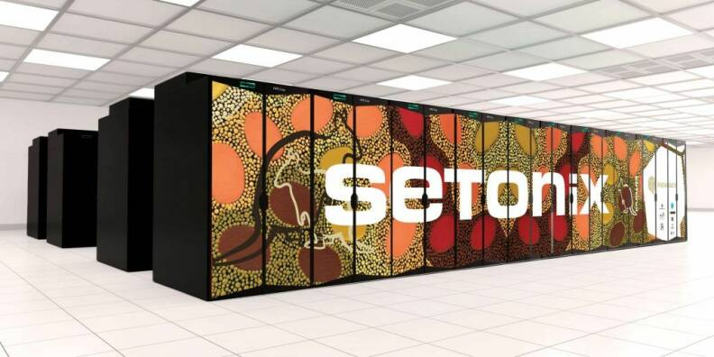
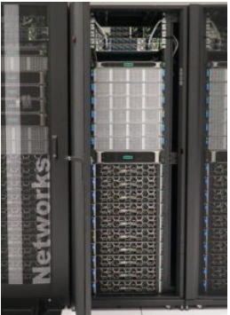
Pawsey Setonix (HPC Cluster)
Pawsey Nimbus (Cloud Service)
Asad Prodhan PhD

Slide 11
Where do I start?
A biological question
Data (new/secondary)
A computer (GUI/CLI)
If CLI, then programing
CLI computing facilities
HPC Cluster, how to connect?
Commercial Cloud services
Google Cloud, Microsoft Azure, and Amazon Web Services (AWS)
Pawsey Nimbus, how to connect?
Apply for Pawsey HPC or Nimbus
Asad Prodhan PhD

Slide 12
Where do I start?
A biological question
Data (new/secondary)
A computer (GUI/CLI)
If CLI, then programing
Asad Prodhan PhD

Slide 13
Where do I start?
A biological question
Data (new/secondary)
A computer (GUI/CLI)
If CLI, then programing
Question > Data > Access to the CLI-based Computer > Now what?
Coding!
Asad Prodhan PhD

Slide 14



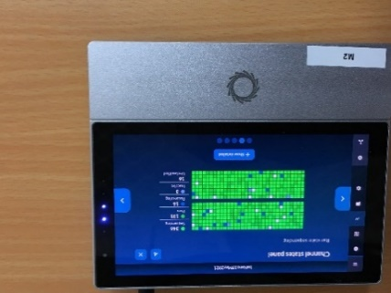
Where do I start?
Question
Data processing
Data generation
CLI-based computers
Raw
Data
Your laptop
Asad Prodhan PhD

Slide 15
Where do I start?
Question
Data processing
Data generation
CLI-based computers
What to learn?
How to set up your laptop for coding?
How to connect to remote computers?
https://github.com/asadprodhan/How-to-connect-to-a-remote-Linux_computer
https://github.com/asadprodhan/How_to_connect_to_Pawsey_nimbus_instance
How to navigate files using CLI? https://github.com/asadprodhan/Invited_talks/blob/main/Command_Line_Basics_AsadProdhan.pdf
How to transfer data?
How to install bioinformatics tools?
https://github.com/asadprodhan/A-beginner-s-guide-to-Bioinformatics
How to carry out your analyses?
Hands-on workshop, YouTube
Steep learning curve!
Raw
Data
Your laptop
Asad Prodhan PhD

Slide 16
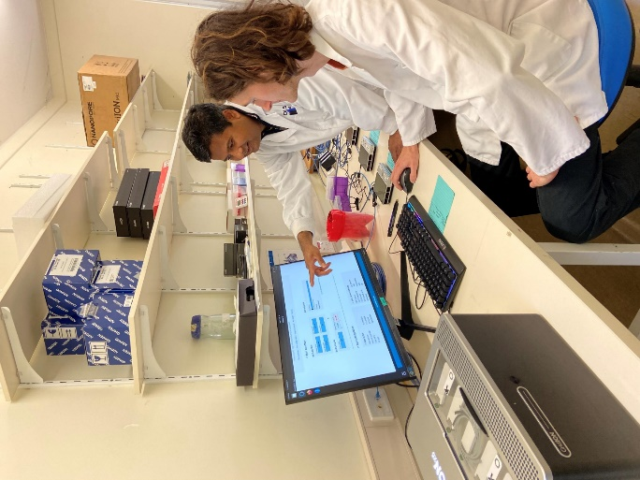
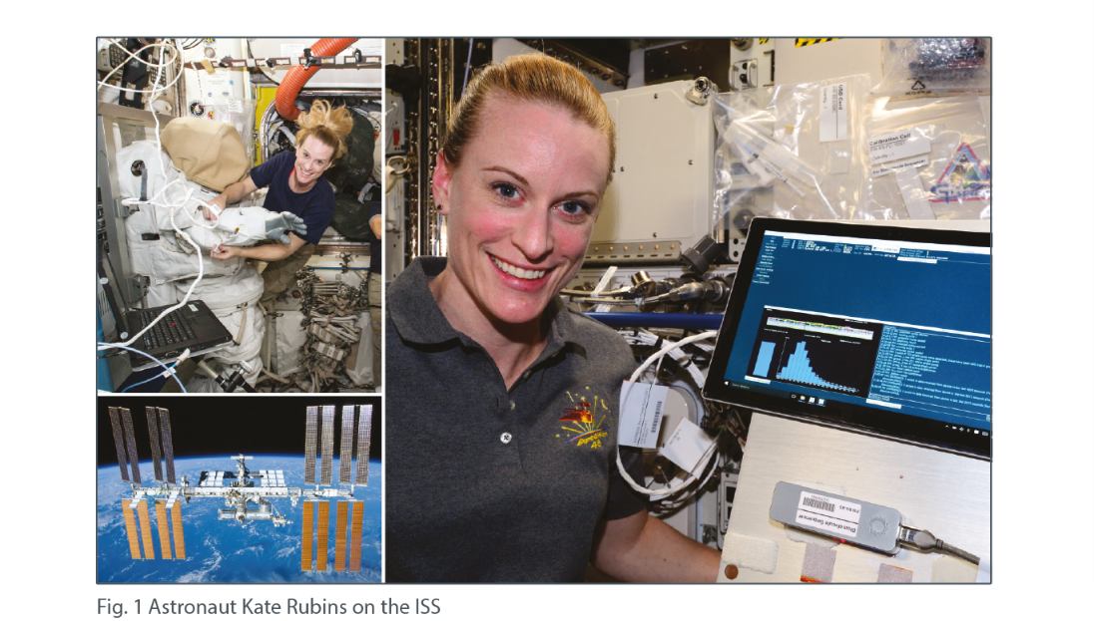
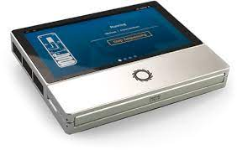
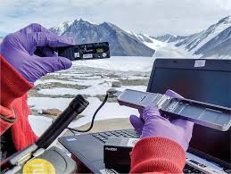
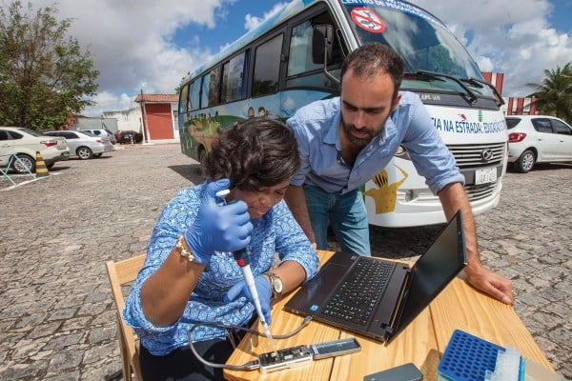
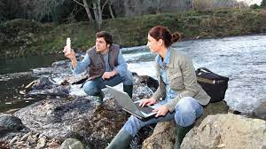
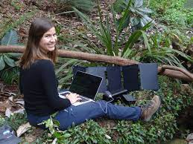
Steep learning curve but REWARDING
Asad Prodhan PhD

